Slide 1
AMS Project I. Visualization of a production line controlled by a PLC
Made by: Nagy Zsolt-F6ZKWV

Slide 2
Contents
Introduction
Used softwares
HW Configuration
Visualization
Controlling
Final demo

Slide 3
Introduction
The main idea was to do a visualization from a production line
Using PLC and its associated development environment
Car production

Slide 4
Used softwares
TIA Portal V13 SP1
- Step7 Professional V13 SP1
- WinCC Professional V13 SP1
- WinCC SCADA Runtime V13 SP1

Slide 5
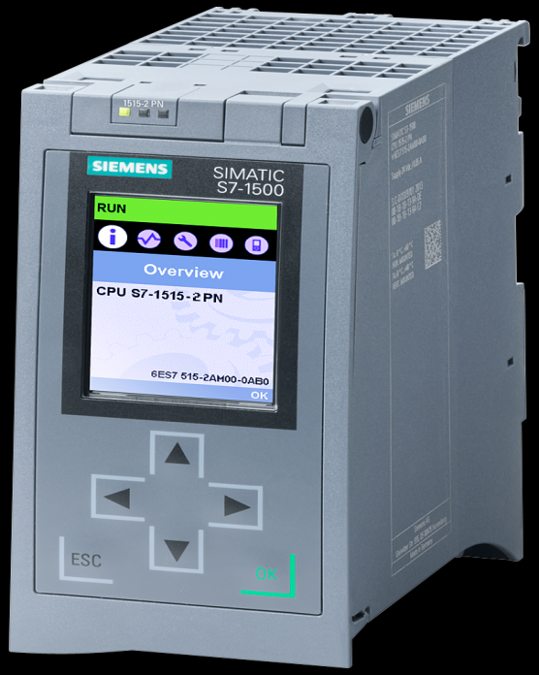
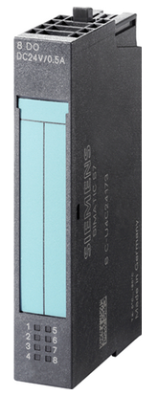
HW Config
Used Siemens S7-1500 PLC
- CPU: 1515-2 PN
Used ET200S I/O module
Used PROFINET communication

Slide 6
Visualization
Building the production line
The components of the visualization
- sensors
- warehouses
- spray booth
- pressing cylinder
- pre-processing unit
- conveyor belt
- pushers

Slide 7
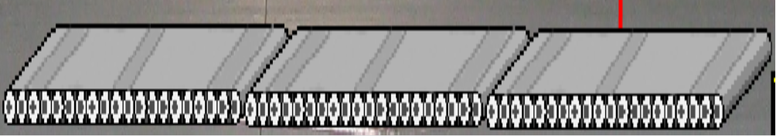
Pictures of components

Slide 8
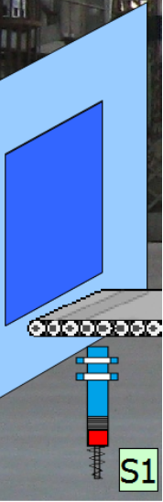
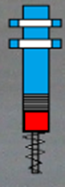
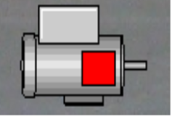
Pictures of components

Slide 9
Controlling
Writing code
Used programming language: LAD, SCL
Dividing into several parts (networks)
1.: from pre-processing unit until pressing cylinder
2.: from pressing cylinder until spray booth
3.: from spray booth until warehouses
Problems: in early phase with the third part but later solved

Slide 10
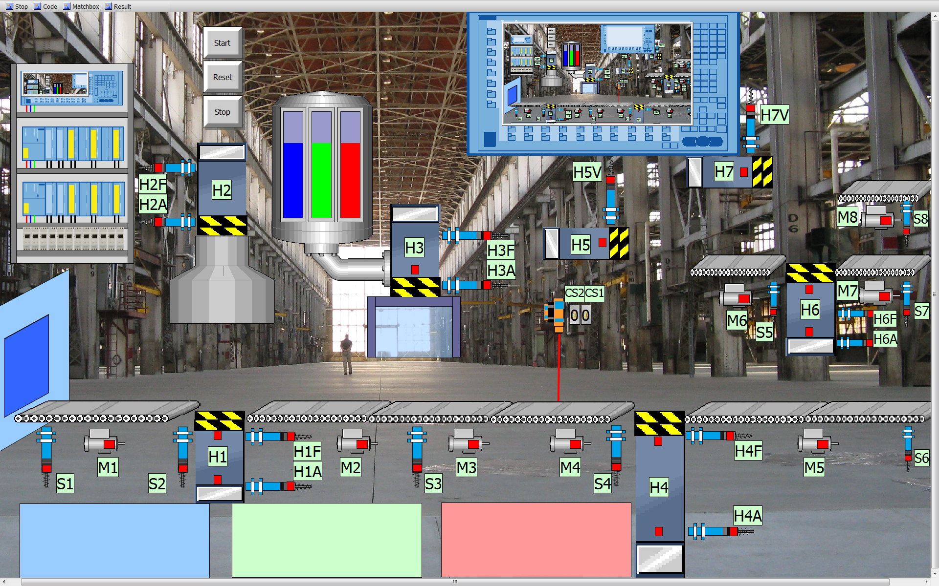
Final demo

Slide 11
Thank you for your attention!

